Slide 1
Naming of baselines and releases on EE system level
Version 2.5

Slide 2
GTT-Electrical and Electronics Engineering
Reg. No.
50160112
Valid date
2012-04-25
Revision date
2012-04-25
Issue number
1
Issuer
Staffan Mossberg
Document type (e.g. Guiding principle, Summarized process guideline, Training, Example, Template etc):
Naming of baselines and releases on EE system level
Approved by
Attila Berényi
This is a part of (process X, organization etc):
GEEE Development Process
Concerned (Role, function, group etc):
GEEE
Purpose of document:
This is a presentation of the new naming convention for baselines and product releases on EE system level.
Short description:
This presentation outlines the new naming convention for baselines and product releases on EE system level. The naming convention has been created by the configuration management team at 26344 with the objective to create a naming convention that is both logical and consistent and that will support parallel development through branching.
Other Information:
The new naming convention is limited to TEA2+ based development with SP-start after w1248 with start from w1204. The existing naming convention (5.x…) will be preserved for the remaining development activities and deliveries in the production branch for SP-start w1248.
Revision history:

Slide 3
Introduction
This is a presentation of the new naming convention for baselines and product releases on EE system level. The naming convention has been created by the configuration management team at 26344 with the objective to create a naming convention that is both logical and consistent and that will support parallel development through branching.
The new naming convention is limited to TEA2+ based development with SP-start after w1248 with start from w1204. The existing naming convention (5.x…) will be preserved for the remaining development activities and deliveries in the production branch for SP-start w1248.

Slide 4
Requirements Development Tracks
16w
16w
16w
Main track
A0
A1
B0
C0
D0
Legend
A0
System Specification Baseline

Slide 5
System Specification Baselines
A0
A = Development Loop
0 = Loop Update

Slide 6
Requirements Development Tracks
16w
16w
16w
Main track
A0
A1
B0
C0
D0
A0_1
A0_n
B0_1
Legend
A0
System Specification Baseline
A0_1
Component Delivery to System Integration
(input to SI)

Slide 7
Component Delivery to System Integration (input to SI)
A0_1
A = Development Loop
0 = Loop Update
_1 = Integration Version
From the applicable System Specification Baseline

Slide 8
Requirements Development Tracks
16w
16w
16w
Main track
A0
A1
B0
C0
D0
A0_1
A0_n
B0_1
Legend
A0
System Specification Baseline
A0_1
Component Delivery to System Integration
(input to SI)
A0_VT01_1.0
System Integration Baseline
(output from SI / input to I5)
A0_VT_REL01_1.0
System Release Baseline

Slide 9
System Integration Baselines (output from SI / input to I5)
A0_VT01_1.0
A = Development Loop
0 = Loop Update
VT = Integration Type
01 = Integration Type Configuration
1.0 = Integration Version
From the applicable System Specification Baseline

Slide 10
Integration Type Configuration
1.0
x.0
A0_VT01
A0_VT02
A0_VT03
SP-start 1
(intro)
SP-start 2
(intro)
A0_VT01_1.0
System Integration Baseline
VT = Integration Type
01 = Integration Type Configuration

Slide 11
System Release Baselines
A0_VT_REL01_1.0
A = Development Loop
0 = Loop Update
VT_REL = Release Type
01 = Release Type Configuration
1.0 = Release Version
From the applicable System Specification Baseline

Slide 12
Requirements Development Tracks - Production Branch
B0P1
B0P2
Production branch
16w
16w
16w
Main track
A0
A1
B0
C0
D0
A0_1
A0_n
B0_1
Legend
A0
/
B0P1
System Specification Baseline
A0_1
Component Delivery to System Integration
(input to SI)
A0_VT01_1.0
System Integration Baseline
(output from SI / input to I5)
A0_VT_REL01_1.0
System Release Baseline

Slide 13
System Specification Baselines
A0
/
B0P1
A = Development Loop
0 = Loop Update
P = Branch Type (existing types: P=Production, D=Development, C=Correction)
1 = Branch Update

Slide 14
Requirements Development Tracks - Production Branch
B0P1
B0P2
Production branch
B0P1_1
B0P2_1
16w
16w
16w
Main track
A0
A1
B0
C0
D0
A0_1
A0_n
B0_1
Legend
A0
/
B0P1
System Specification Baseline
A0_1
/
B0P1_1
Component Delivery to System Integration
(input to SI)
A0_VT01_1.0
/
B0P1_VT01_1.0
System Integration Baseline
(output from SI / input to I5)
A0_VT_REL01_1.0
/
B0P_VT_REL01_1.0
System Release Baseline

Slide 15
Component Delivery to System Integration (input to SI)
A0_1
/
B0P1_1
A = Development Loop
0 = Loop Update
P = Branch Type
1 = Branch Update
_1 = Integration Version
From the applicable System Specification Baseline

Slide 16
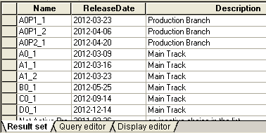
List of Component Deliveries to System Integration in ClearQuest

Slide 17
System Integration Baselines (output from SI / input to I5)
A0_VT01_1.0
/
B0P1_VT01_1.0
A = Development Loop
0 = Loop Update
P = Branch Type
1 = Branch Update
VT = Integration Type
01 = Integration Type Configuration
1.0 = Integration Version
From the applicable System Specification Baseline

Slide 18
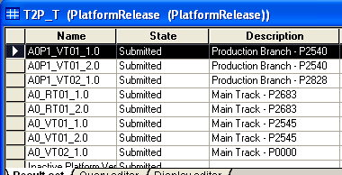
System Integration Baselines corresponds to Platform Releases in ClearQuest

Slide 19
System Release Baselines
A0_VT_REL01_1.0
/
B0P_VT_REL01_1.0
A = Development Loop
0 = Loop Update
P = Branch Type
VT_REL = Release Type
01 = Release Type Configuration
1.0 = Release Version
From the applicable System Specification Baseline

Slide 20
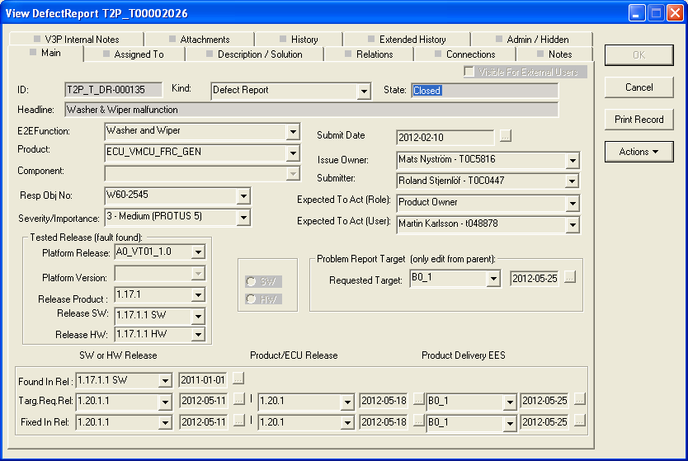
Defect Report with the new Name Convention

Slide 21
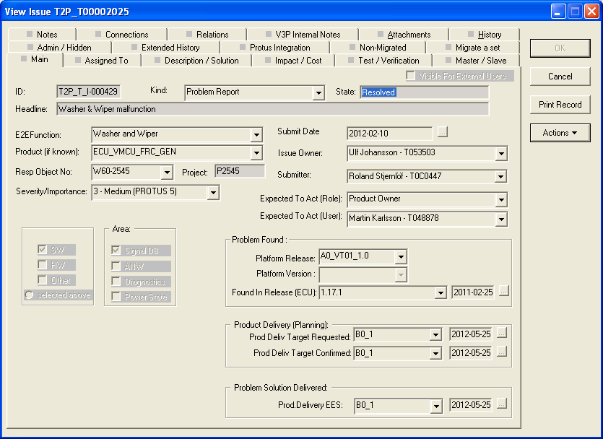
Problem Report with the new Name Convention

Slide 22
Comparison old vs new
Old baseline names | New baseline names
5.5 | B0 / B0P1
5.5.1 | B0_1 / B0P1_1
5.5.VT.01 | B0_VT01_1.0 / B0P1_VT01_1.0
5.5.CV.01 | B0_VT_REL01_1.0 / B0P_VT_REL01_1.0

Slide 23
Current tracks and branches
5.3.A
5.3.B osv
5.4
w1248 Production branch
5.3.x
5.3.y
5.4.x
Main track
5.3
A0
B0
B0_1
Legend
B0
/
5.3.A
System Specification Baseline
B0_1
/
5.3.x
Component Delivery to System Integration
(input to SI)
B0_VT01_1.0
/
5.3.VT.yy
System Integration Baseline
(output from SI / input to I5)
B0_VT_REL01_1.0
/
5.3.CV.zz
System Release Baseline

Slide 24
Thank you!

Slide 25
Requirements Development Tracks
B0P1
B0P2
Production branch
B0P1_1
B0P2_1
16w
16w
16w
Main track
A0
A1
B0
C0
D0
A0_1
A0_n
B0_1
Legend
A0
/
B0P1
System Specification Baseline
A0_1
/
B0P1_1
Component Delivery to System Integration
(input to SI)
A0_VT01_1.0
/
B0P1_VT01_1.0
System Integration Baseline
(output from SI / input to I5)
A0_VT_REL01_1.0
/
B0P_VT_REL01_1.0
System Release Baseline

